Slide 1
Project D: Dashboards are dead
Ashwin Prabou

Slide 2
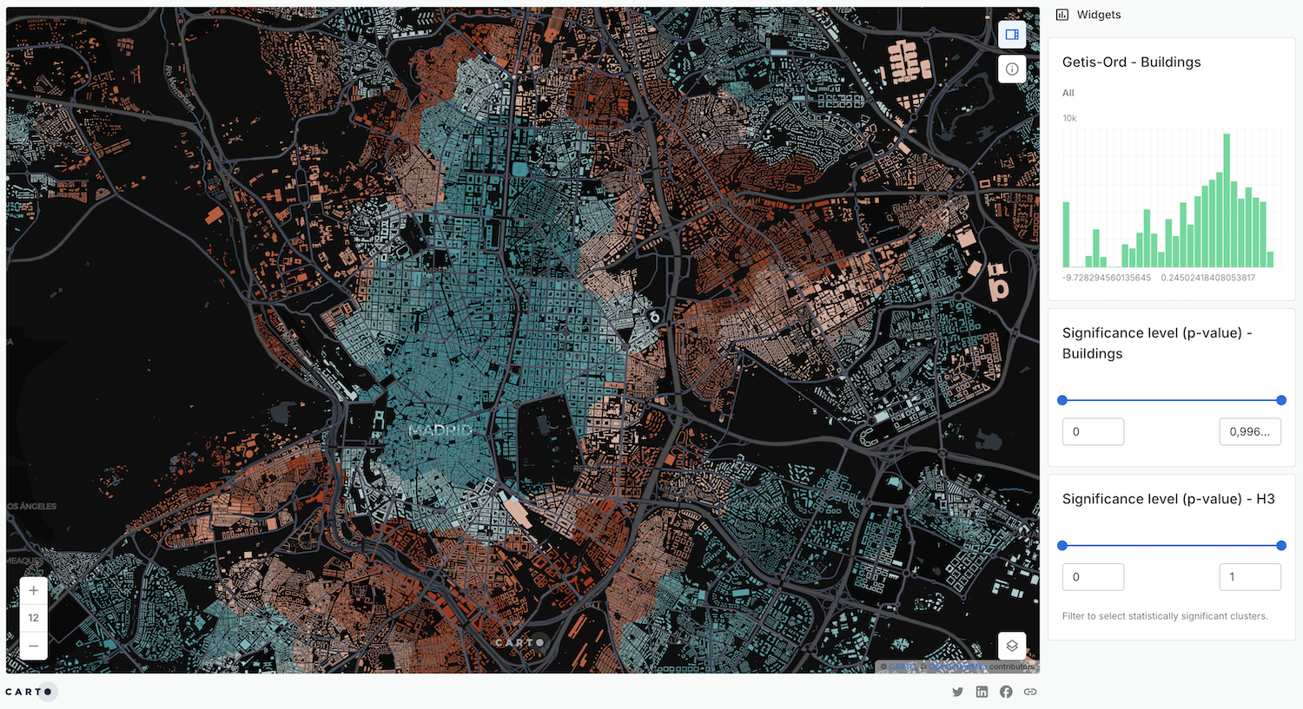
Context
What is a way we can empower users in data exploration?
Proof-of-concept: 1 text file that is both human and LLM-readable
Key questions?
Key deliverables

Slide 3
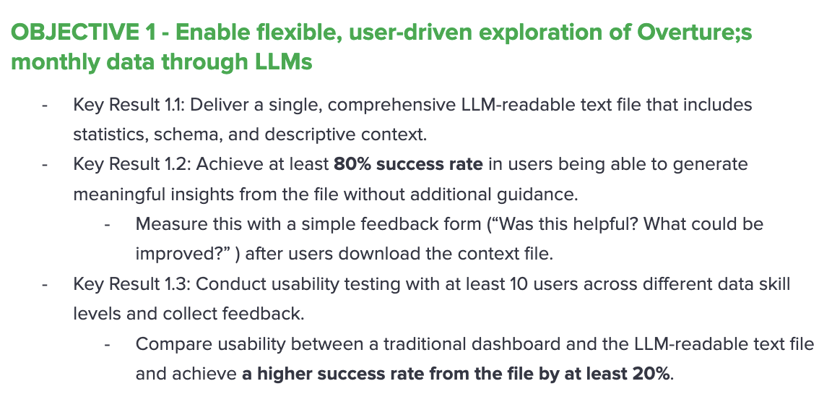
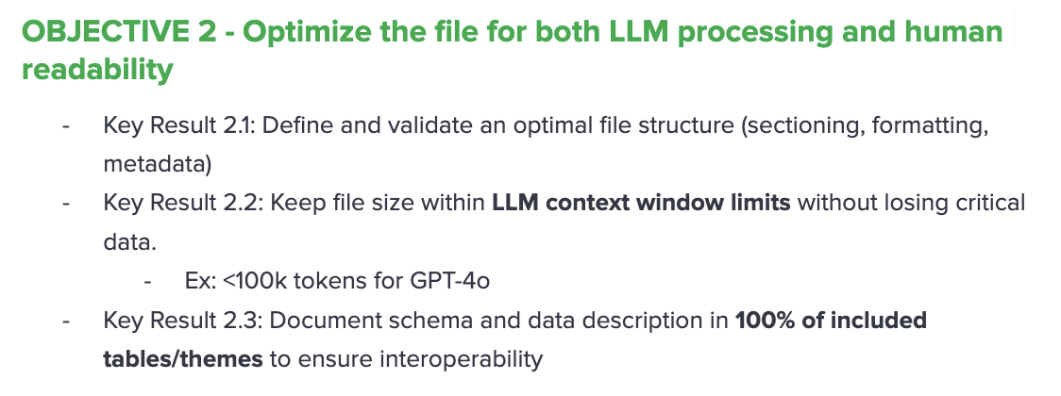
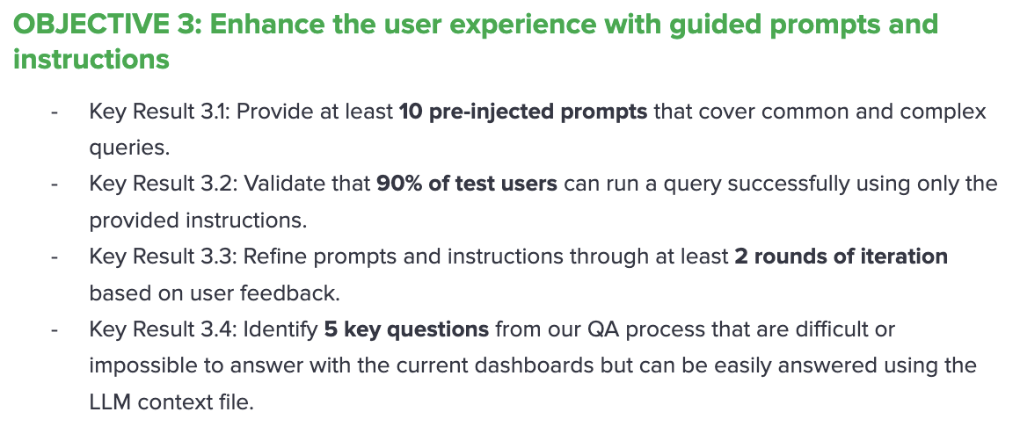
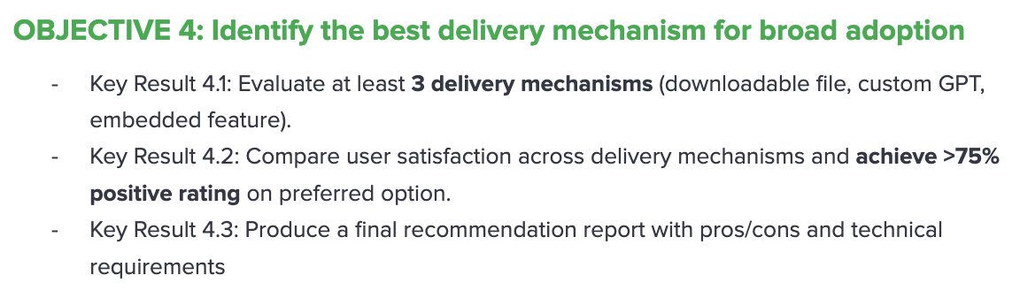
Objectives & Key Results

Slide 4

Demo (try it out yourself
@ project-terraforma.github.io/Ashwin-DaD/

Slide 5
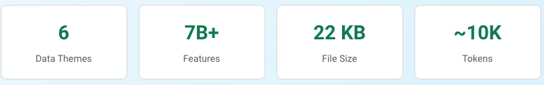
Outcomes
2.3
2.2

Slide 6
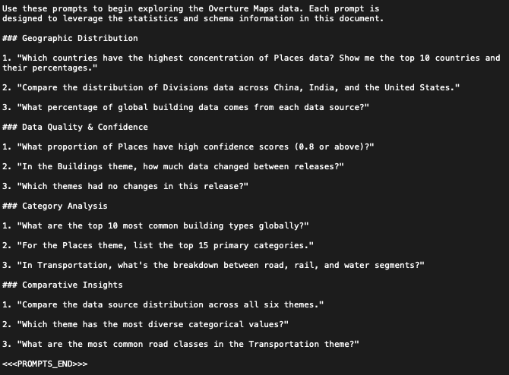
Outcomes
3.1
2.1
LLM Helper Markers**: `<<<INSTRUCTIONS_START>>>`, `<<<SCHEMA_START>>>`, `<<<PROMPTS_START>>>`

Slide 7
Next steps

